Slide 1

LIST IN HTML

Slide 2
Ordered lists are lists where each item in the list is numbered. For example, the list might be a set of steps for a recipe that must be performed in order, or a legal contract where each point needs to be identified by a section number
Unordered lists are lists that begin with a bullet point (rather than characters that indicate order).
Definition lists are made up of a set of terms along with the definitions for each of those terms

Slide 3
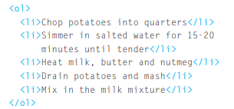
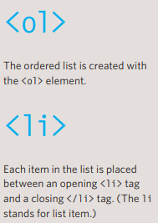

ORDERED LIST
👉👉

Slide 4
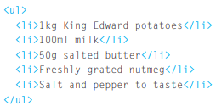
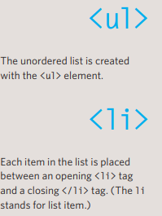

UNORDERED LIST
👉👉

Slide 5
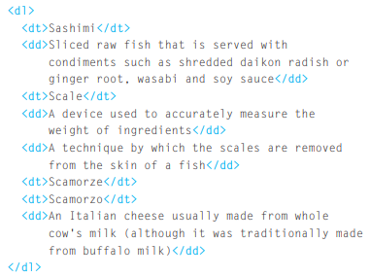
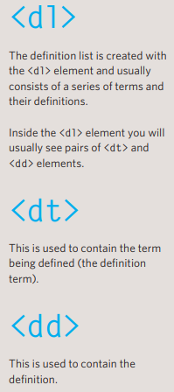
DEFINATION LIST
👉👉

Slide 6
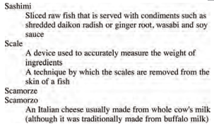
DEFINATION LIST

Slide 7
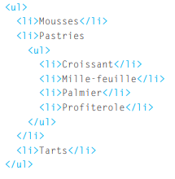
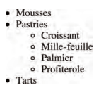
NESTED LIST
👉👉👉👉

Slide 8
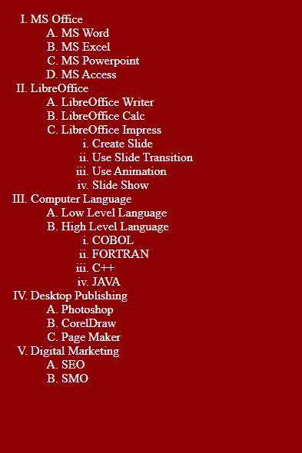
DO IT YOURSELF

Slide 9
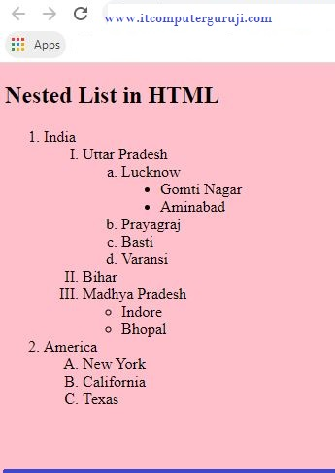
DO IT YOURSELF

Slide 10
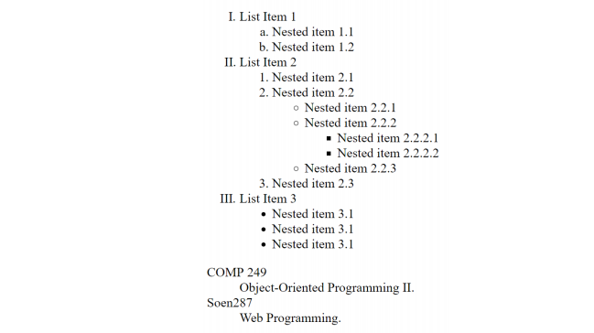
DO IT YOURSELF

Slide 11
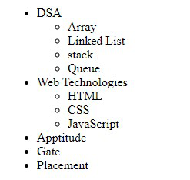
DO IT YOURSELF

Slide 12
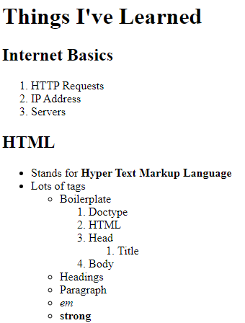
DO IT YOURSELF

Slide 13
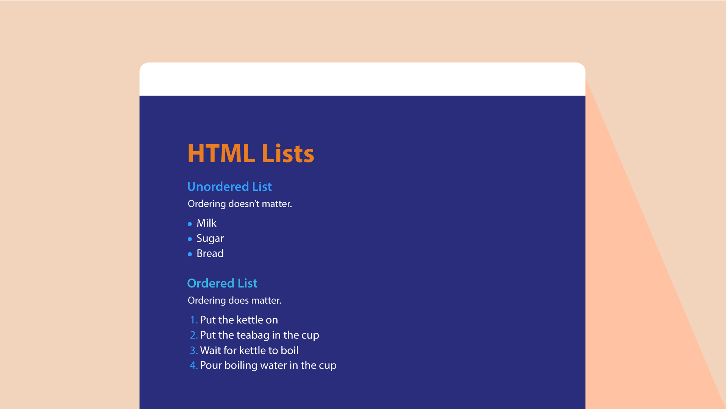

Slide 14
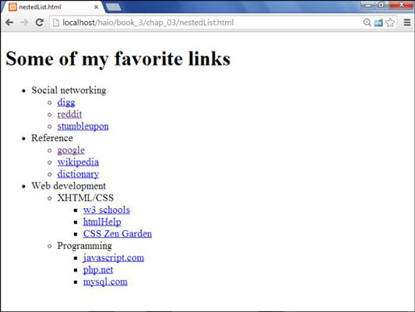

Slide 15
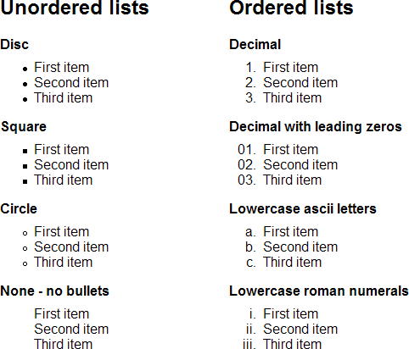

Slide 16
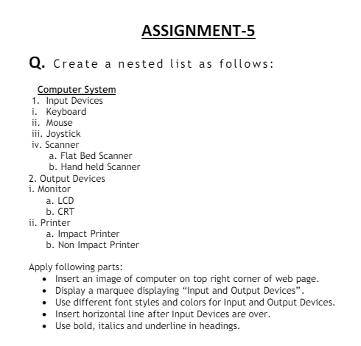


Slide 17
SUMMARY
There are three types of HTML lists: ordered, unordered, and definition.
Ordered lists use numbers.
Unordered lists use bullets.
Definition lists are used to define terminology.
Lists can be nested inside one another.

